Slide 1
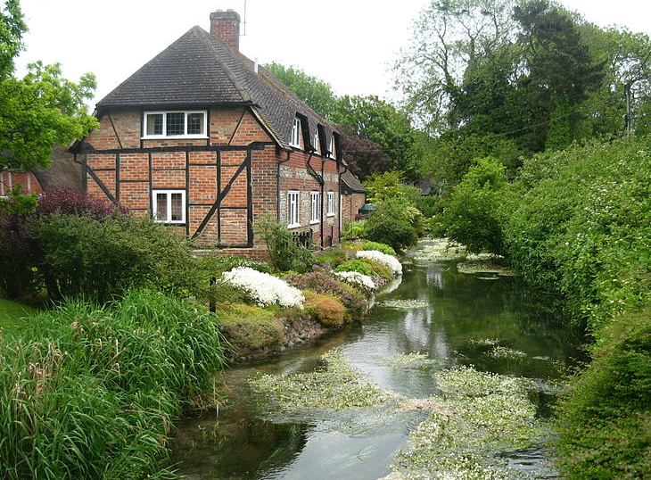
Environmental flows in Europe
Mike Acreman

Slide 2
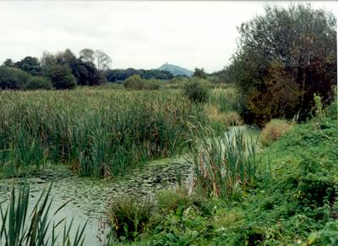
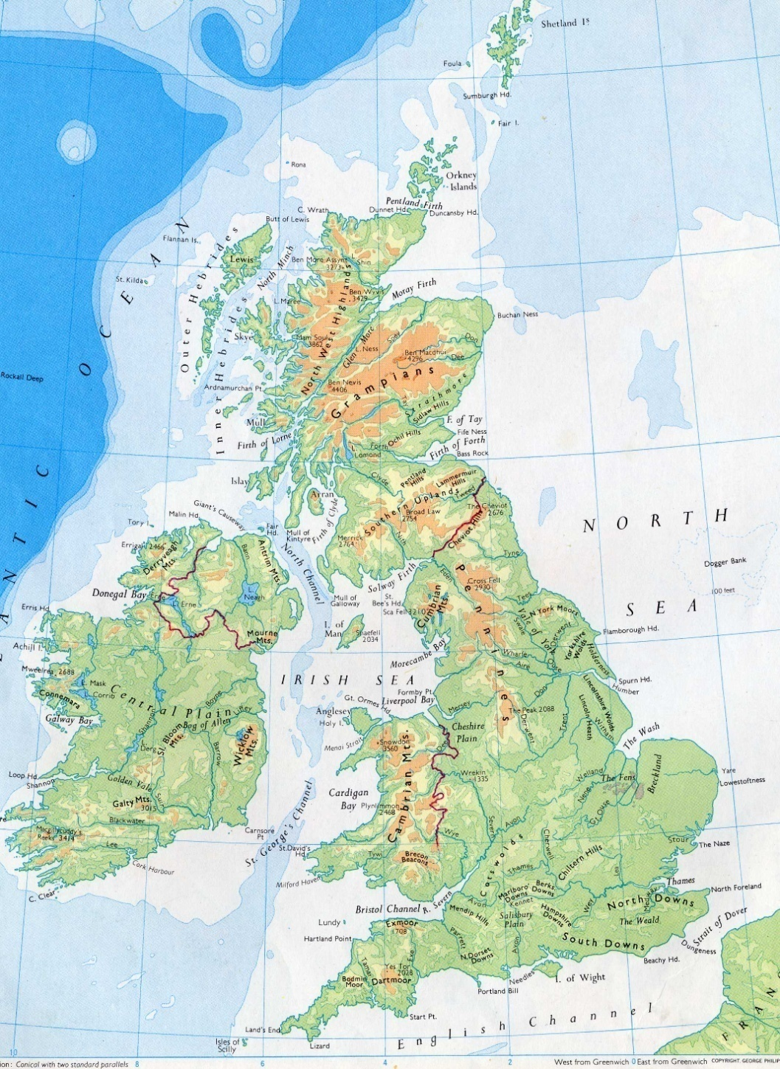
Green and pleasant land?
Thames basin
10,000 km²
650 mm rainfall
15 million people
significant water stress
recycled 7 times

Slide 3
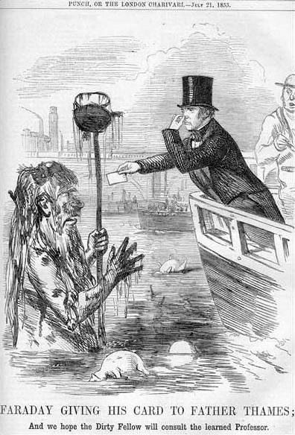
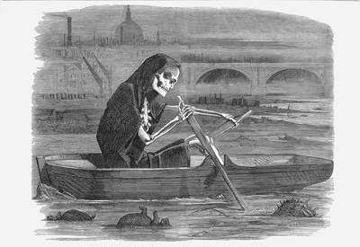
The River Thames 1858
The Great Stink
Smell of Thames - untreated human waste and effluent
Parliament suspended
Prompted sewerage

Slide 4
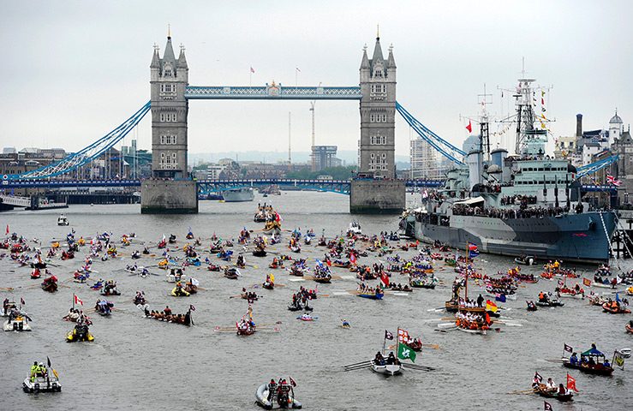
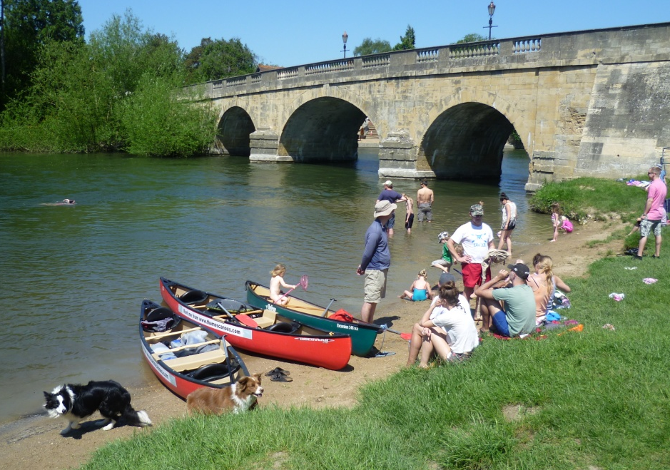
The River Thames 2008
Fishing, boating, swimming ....
Spiritual re-connection
Eco services restored e.g. water purification
2015 Winner of International Theiss River Prize

Slide 5
150 years of work
Clear long term vision
A journey with people
Key steps
1865 2015
sewerage installed
industrial pollution control
environmental flows
nutrients (P stripping)
nano-particles, oestrogen
water trading

Slide 6
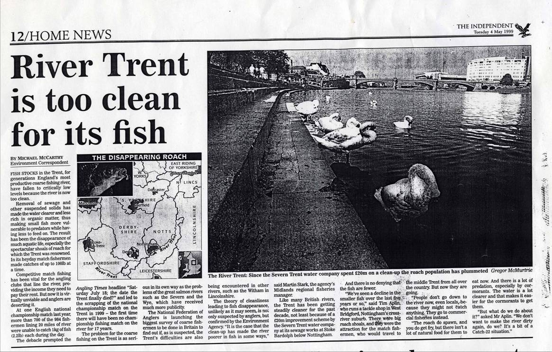
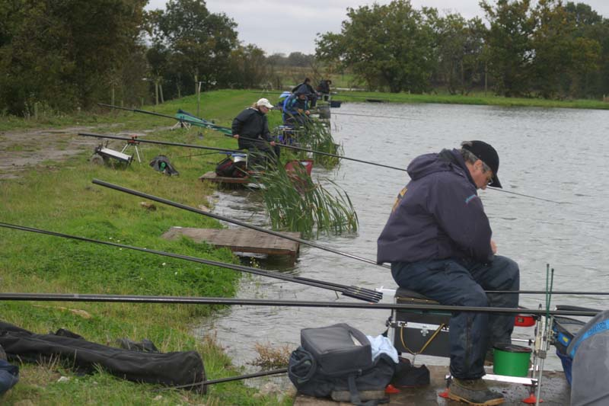
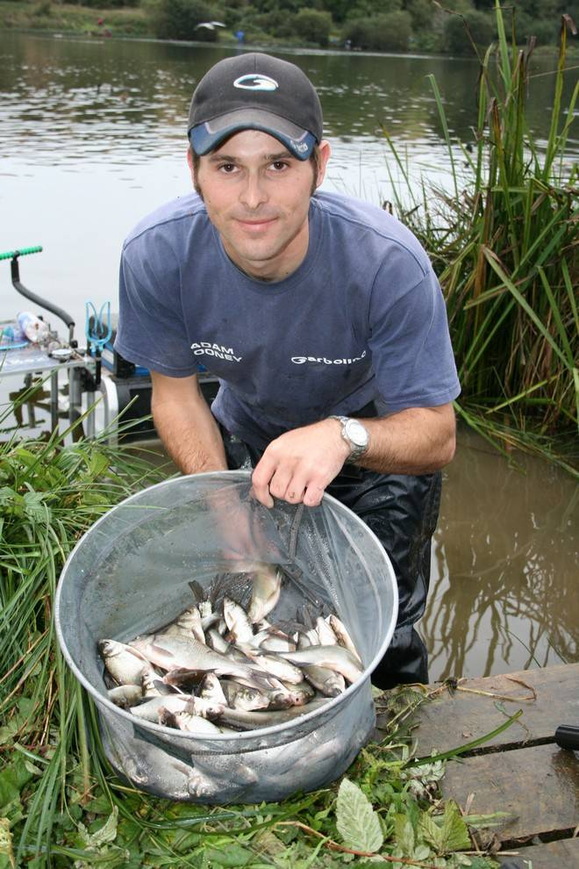
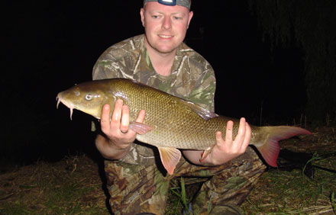
You can’t please all of the people all of the time

Slide 7
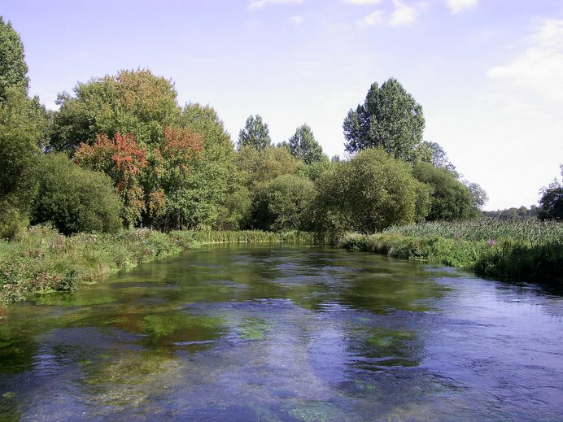
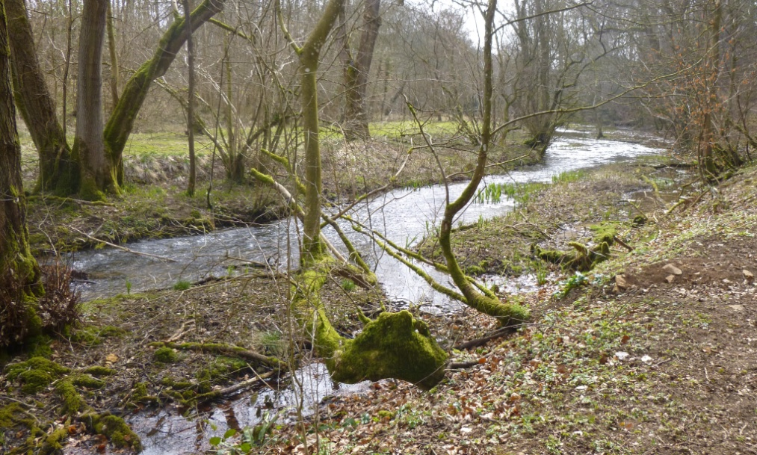
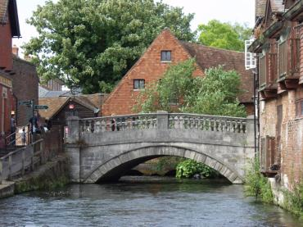
but you can please some people some of the time
2000 years of management
Important heritage
Protected for managed habitats
Natural conditions not desirable

Slide 8
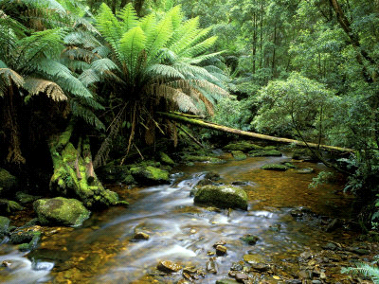
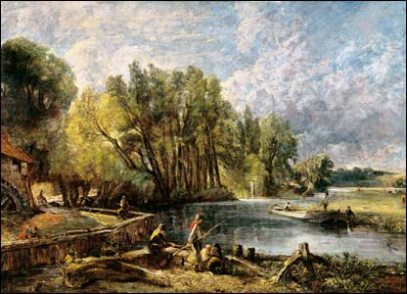
Which reference conditions?
natural
10,000 BC
golden age
1821
when I was young

Slide 9
European Water Framework Directive
Reference Conditions
Ecological Status
(nearly) totally undisturbed
slight alterations
moderate alterations
major alterations
severe alterations
High
OK
Good
Moderate
Poor
measures
needed
Bad
can’t do
Good Ecological Potential
Notes:
GES defined as “slight deviation from Reference Conditions”
Reference conditions equate to conditions at ‘High Ecological Status’

Slide 10
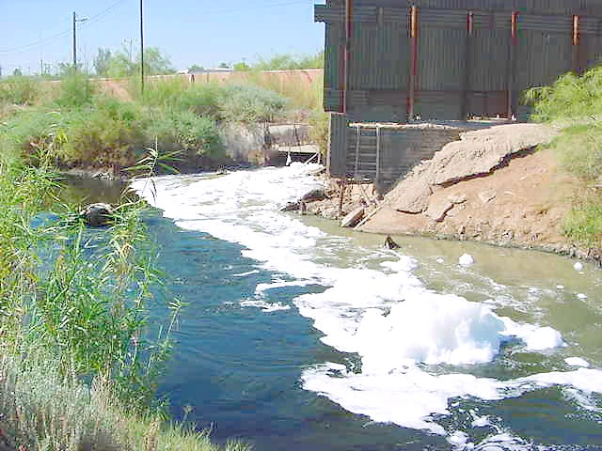
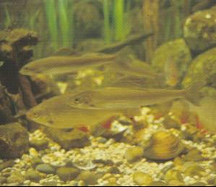
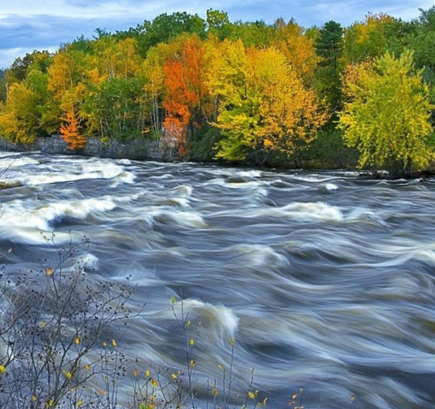
Integrated status
Chemical status - pollutants, oxygen, acidity ...
Biological status - algae, macrophytes inverts, fish
Hydro-morphology – flow, channel naturalness

Slide 11
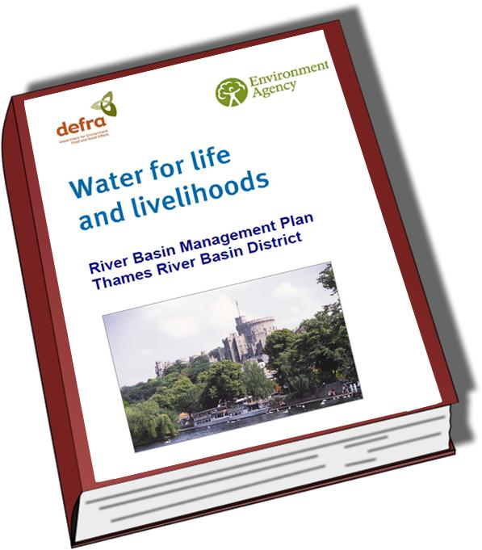
Thames River Basin Plan
Contents
Current state
Actions to improve
Future state (targets)
Implementation plan
Adaptive management
developed through consultations with organisations and individuals

Slide 12
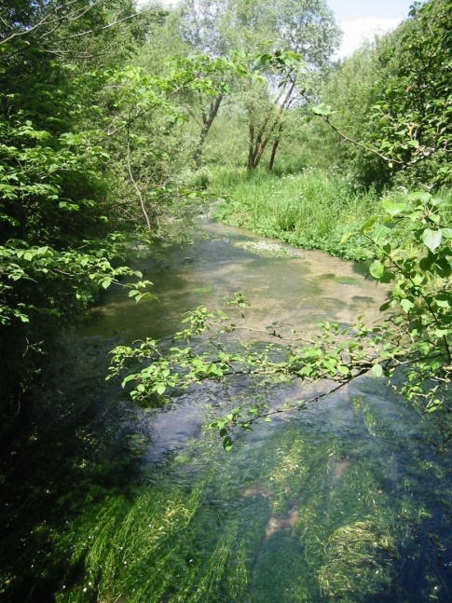
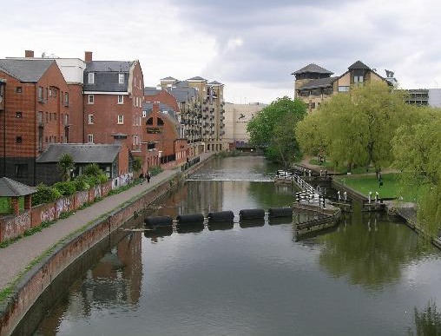
River management classes
High class - natural
Good - semi-natural Moderate - working river
Bad - polluted river

Slide 13

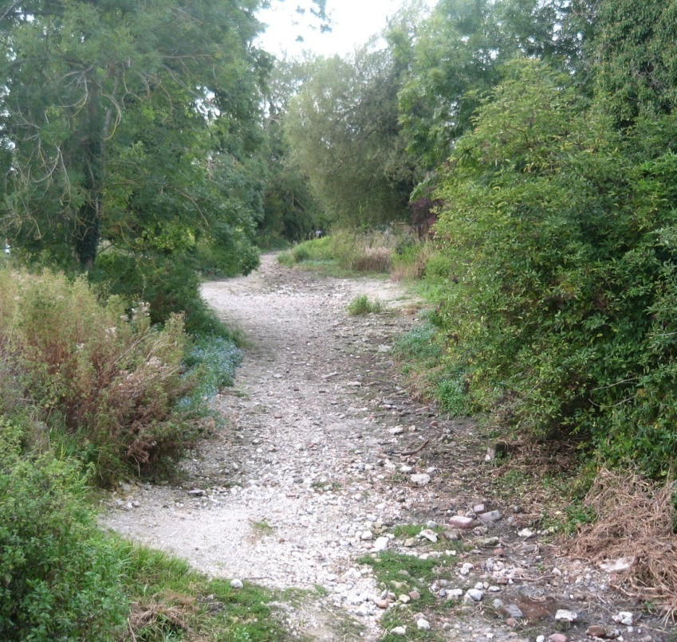
2012 Blueprint to Safeguard Europe's Water Resources
Pressure on river ecosystems
No 1 pressure = dams, land drainage; flood embankments
No 2 pressure = over-abstraction of water → identification of “ecological flow”

Slide 14
Natural river flows
channel maintenance flood
floodplain connectivity
maintenance flows for spawning and dispersal
freshet trigger flows for migration
low flows for juveniles
not right
J F M A M J J A S O N D
All aspects of the flow regime are important for some element of the river ecosystem

Slide 15
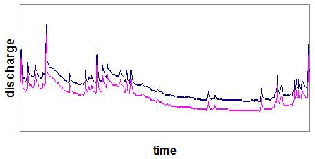
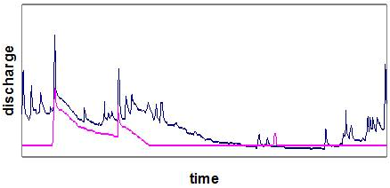
Specifying environmental flows
Direct abstraction
Reduced baseline – maintain variability
Restrictive management
Impoundment
Magnitude and variability may be reduced; magnitude may be increased
Active management

Slide 16
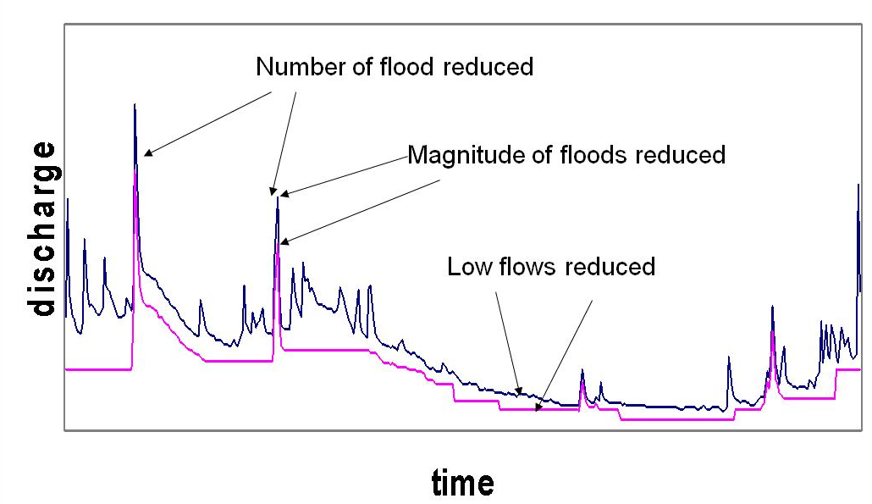
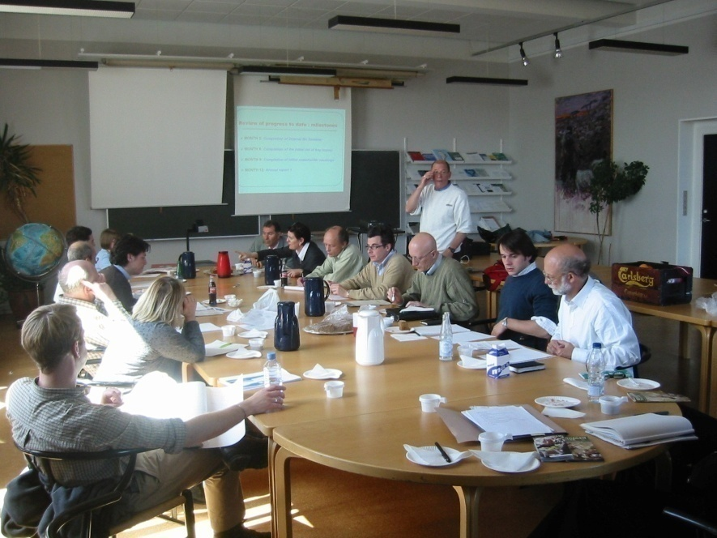
Abstraction management
How much can we alter the flow regime ...
... but maintain desired conditions?
Current UK standards -developed by expert panels – i.e. synthesis of knowledge and experience

Slide 17
Maximum abstractions % to meet GES
High flow
Medium
flow
Low flow
Drought
Lowland meandering
Middle reaches
Headwaters

Slide 18
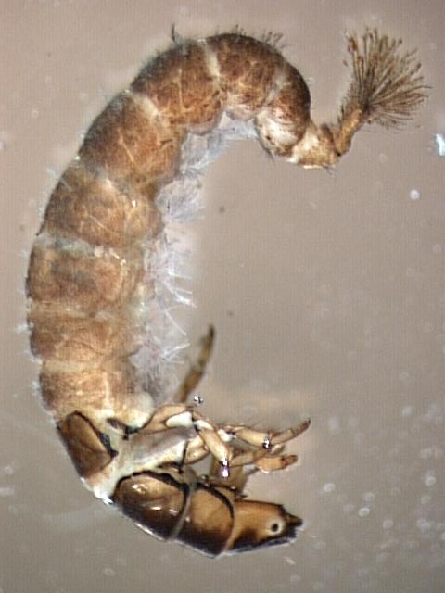
UK Evidence of ecological response to flow
2001
LIFE score
1991
2009
1997
Flow index
No threshold

Slide 19
River sensitivity
sensitive rivers
low abstraction
Ecosystem score
Ecosystem score
Ecosystem score
flow
flow
flow
robust rivers
high abstraction
Ecosystem score
Ecosystem score
Ecosystem score
flow
flow
flow

Slide 20
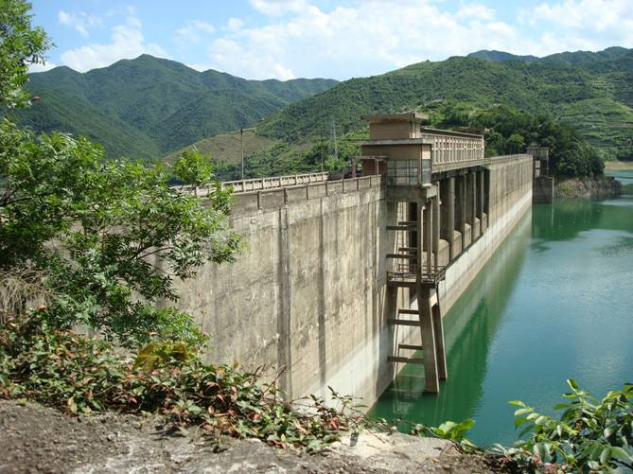
Impoundment releases
Heavily Modified Water Body
Target = Good Ecological Potential
Best practice
Stakeholder objectives
Dams have major control over flow regime
Design flow releases to meet desired ecosystem services

Slide 21
E-flow releases for GEP
channel maintenance flood
floodplain connectivity
maintenance flows for spawning and dispersal
freshet trigger flows for migration
low flows for juveniles
Quantity – magnitude, timing, duration, frequency
Quality – temperature, sediment

Slide 22
E-flow release regime
environmental flow
natural flow

Slide 23
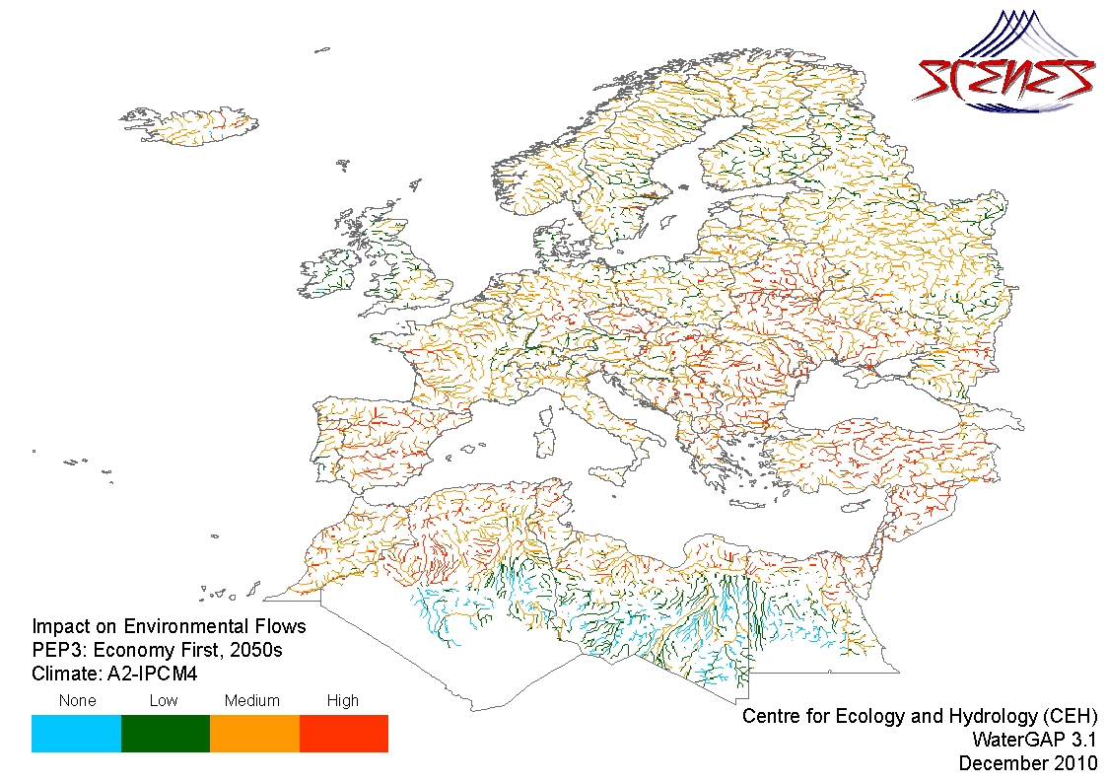
Risk of future ecological impact from hydrological alteration

Slide 24
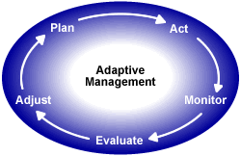
Adaptive management
E-flow assessments uncertain
Responses un-predicable
Circumstances change
Need to act, monitor, evaluate and adjust
Not admission of error

Slide 25
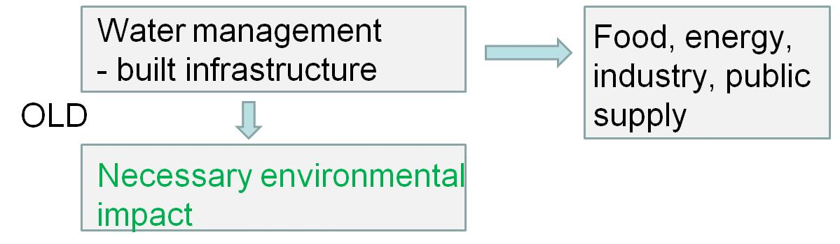
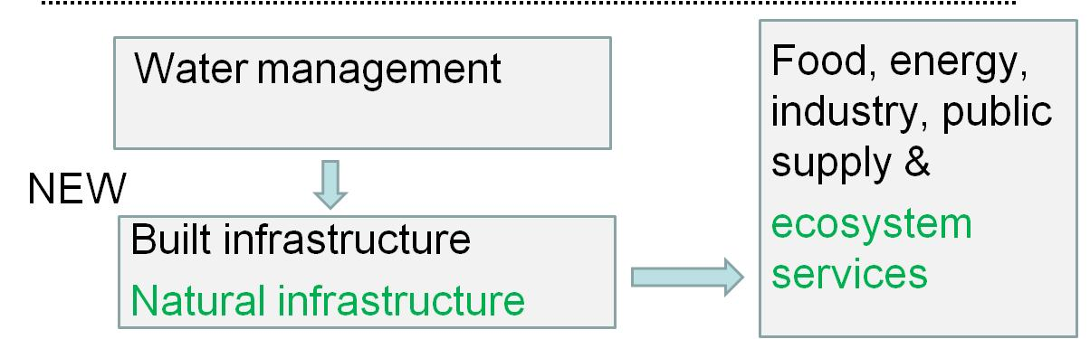
Paradigm change (after WWAP)
EIA
EOA

Slide 26
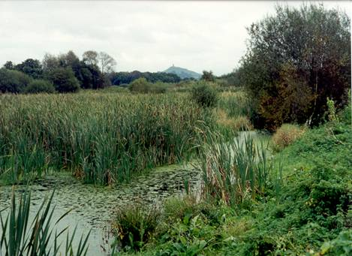
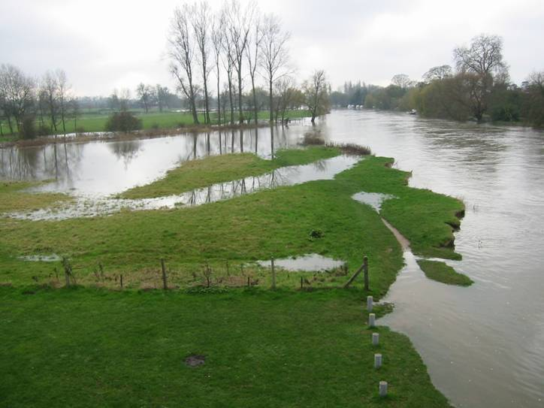
Solutions in Thames
wetlands, floodplains restoration to store water and purifies it naturally
- multiple benefits
e.g. human health
Water trading; water saved can be sold to another user
New reservoir – last resort

Slide 27
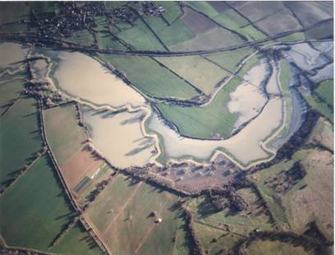
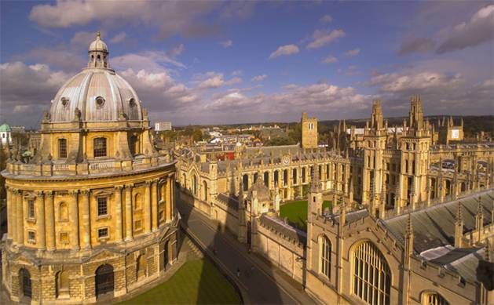

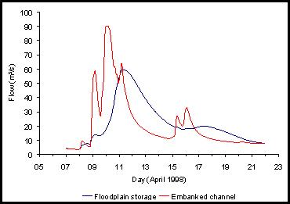
Floodplain wetlands control floods
with no floodplain
1998 flood flow Oxford

Slide 28
Conclusions
Decide what you want to achieve
Set long term goal and small steps
Define baseline and objectives
No simple answer, choose appropriate method
Develop indicators that response to flow
Define impacts of future climates/water needs
Looks for opportunities of ecosystems
Take adaptive management approach

Slide 29
THANK YOU

